Slide 1
Who is the real Shane Keisel?
Subtitle or details about the presentation can go in this space.
November 29, 2016

Slide 2
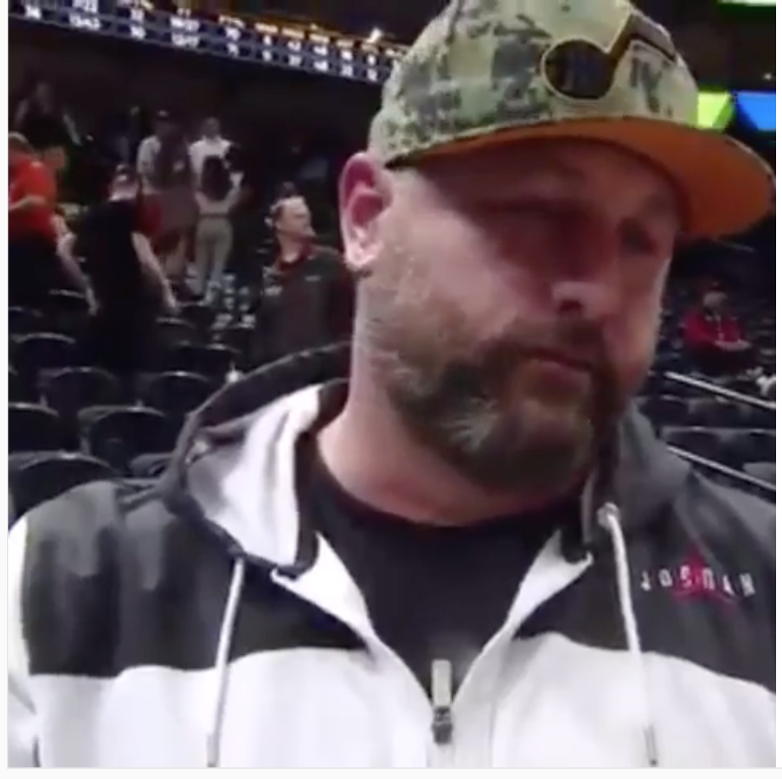
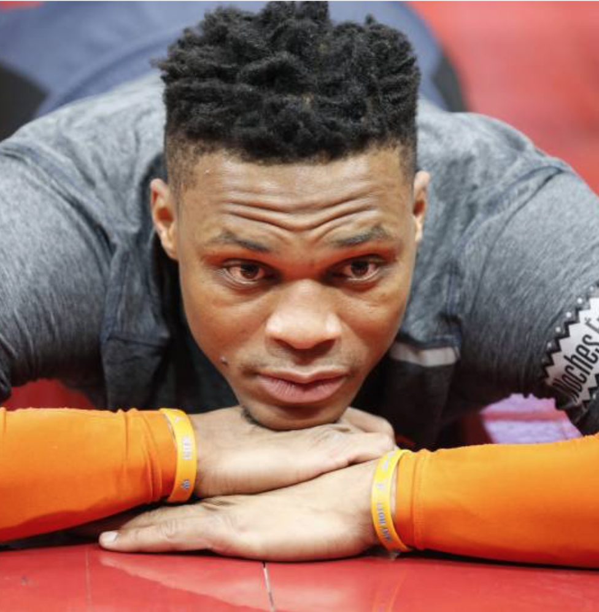
Story begins with a verbal altercation in 2nd Quarter
https://twitter.com/JJSportsBeat/status/1105317021686751234 https://bleacherreport.com/articles/2825288-jazz-ban-fan-shane-keisel-for-life-after-russell-westbrook-altercation https://www.si.com/nba/2019/03/12/russell-westbrook-thunder-jazz-fan-shane-keisel-adam-silver

Slide 3
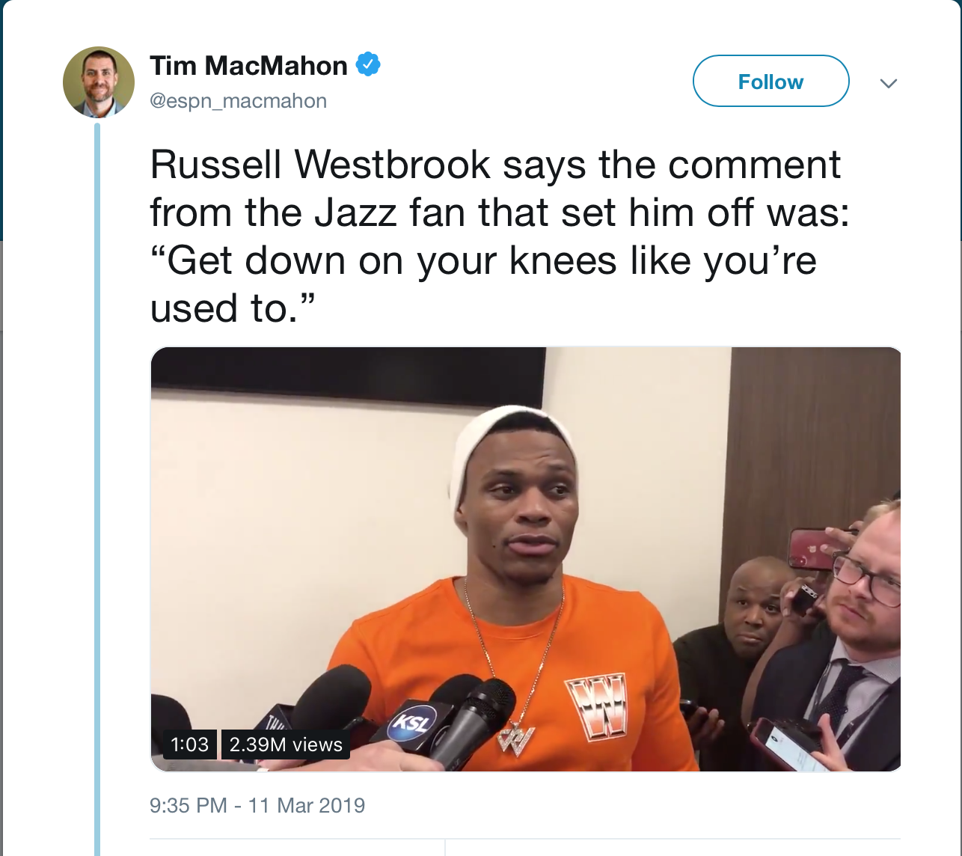
Russell responded to comments he says were racist
https://twitter.com/espn_macmahon/status/1105326442173198336

Slide 4
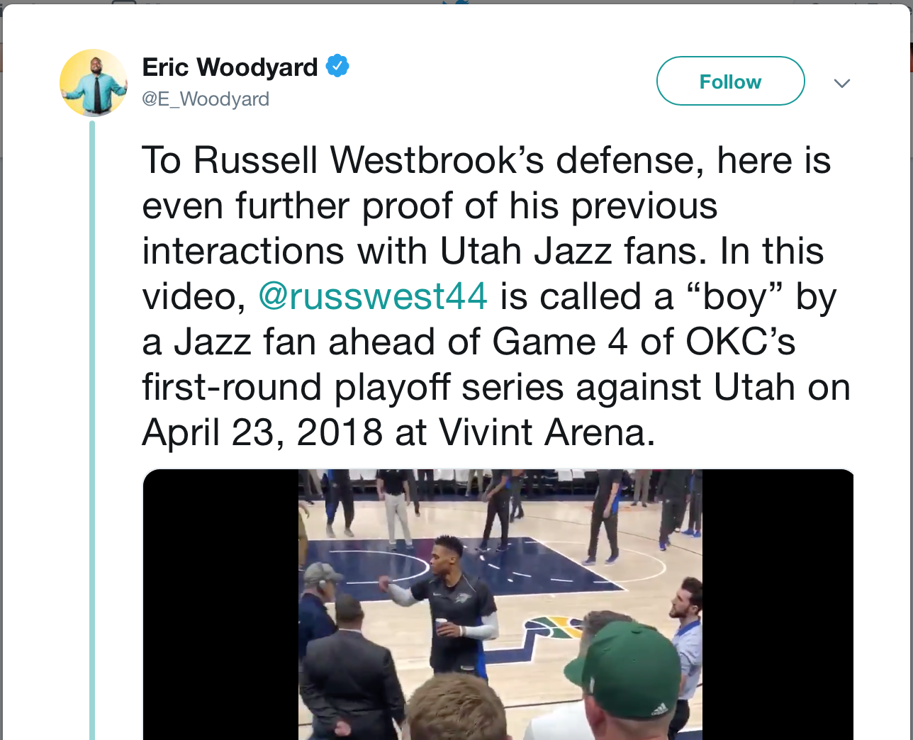
Last year in game 4 of the playoffs, Russ responds to a different Jazz fan
https://web.archive.org/web/20190403153304/https://twitter.com/E_Woodyard/status/1105661865038893057

Slide 5
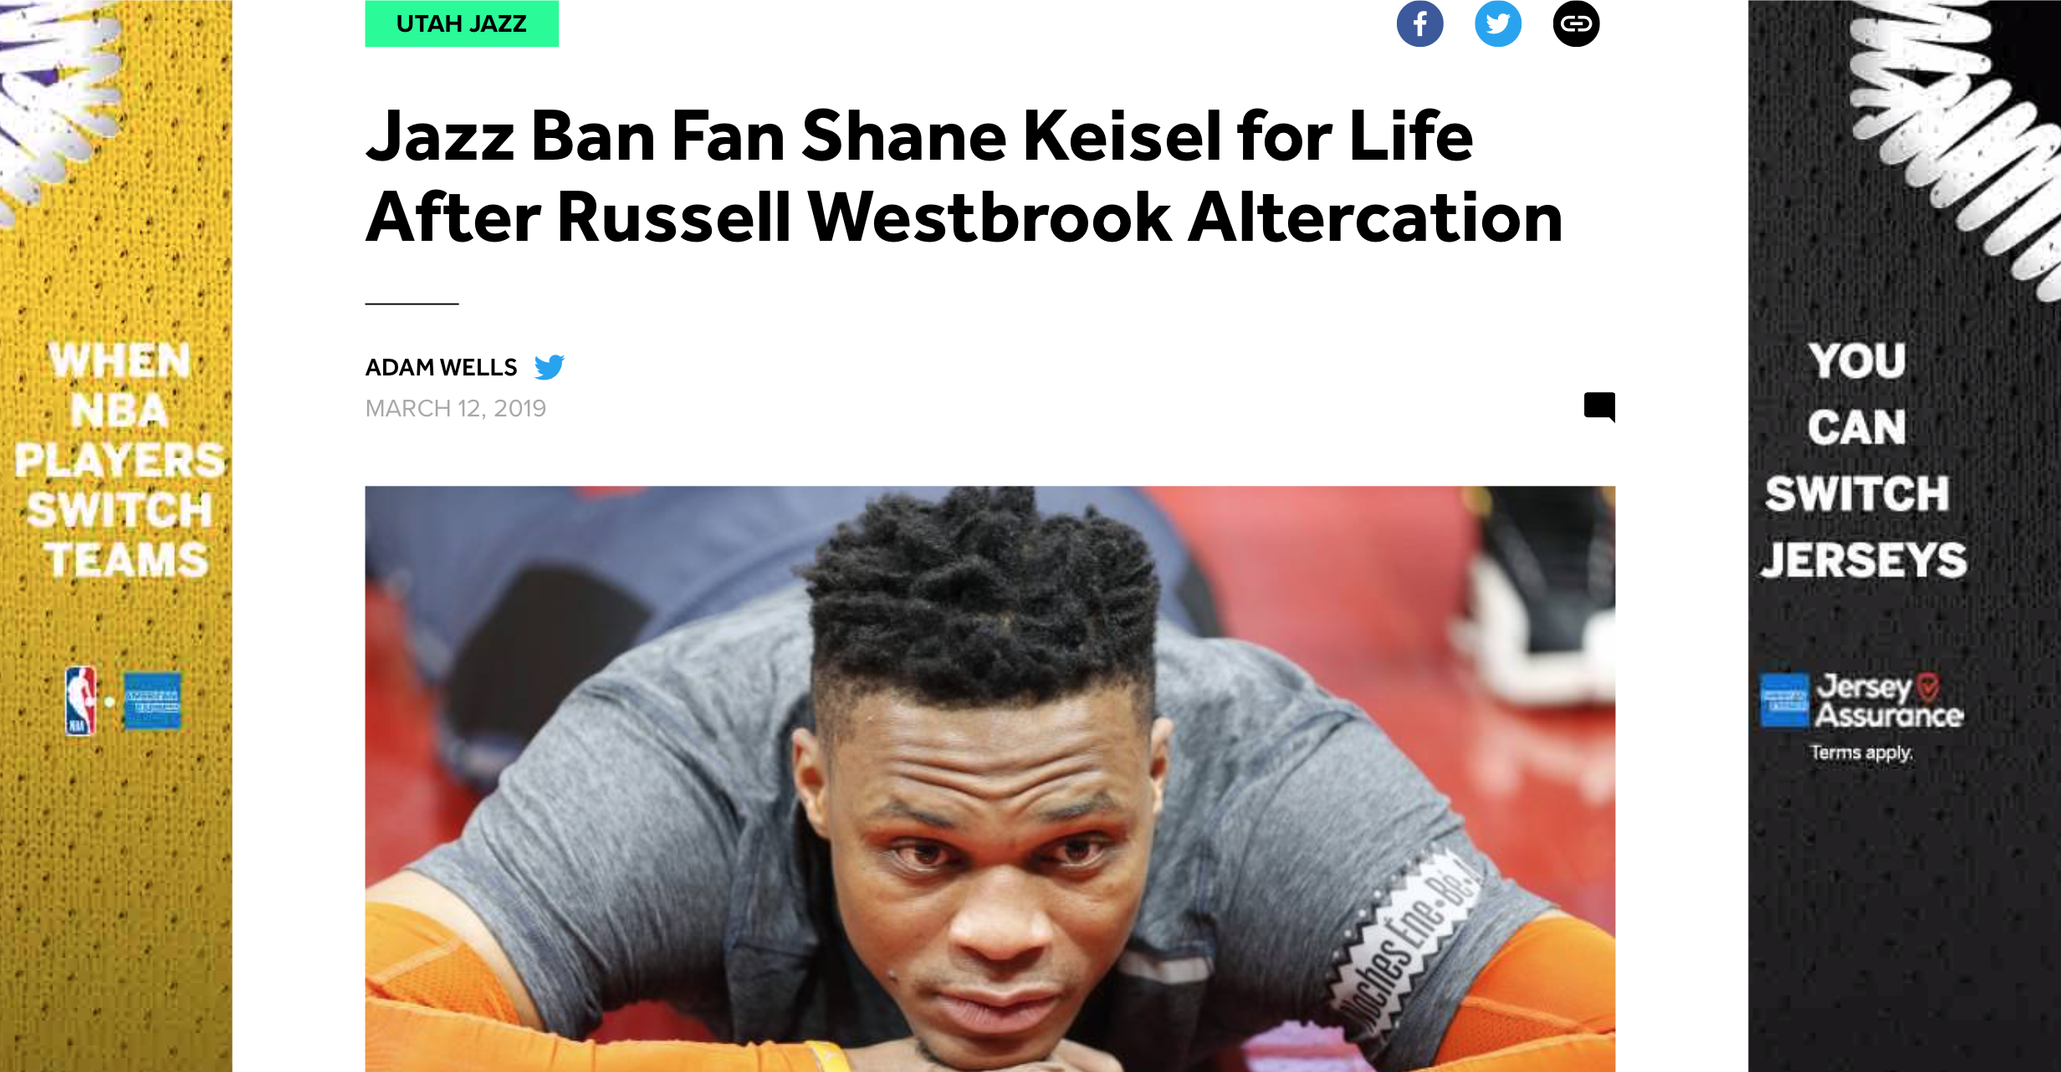
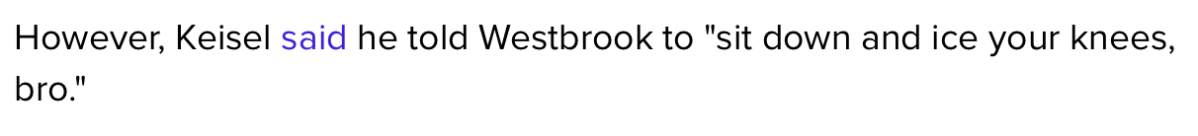
Keisel disputes the claim that his comments were racist
https://bleacherreport.com/articles/2825288-jazz-ban-fan-shane-keisel-for-life-after-russell-westbrook-altercation

Slide 6
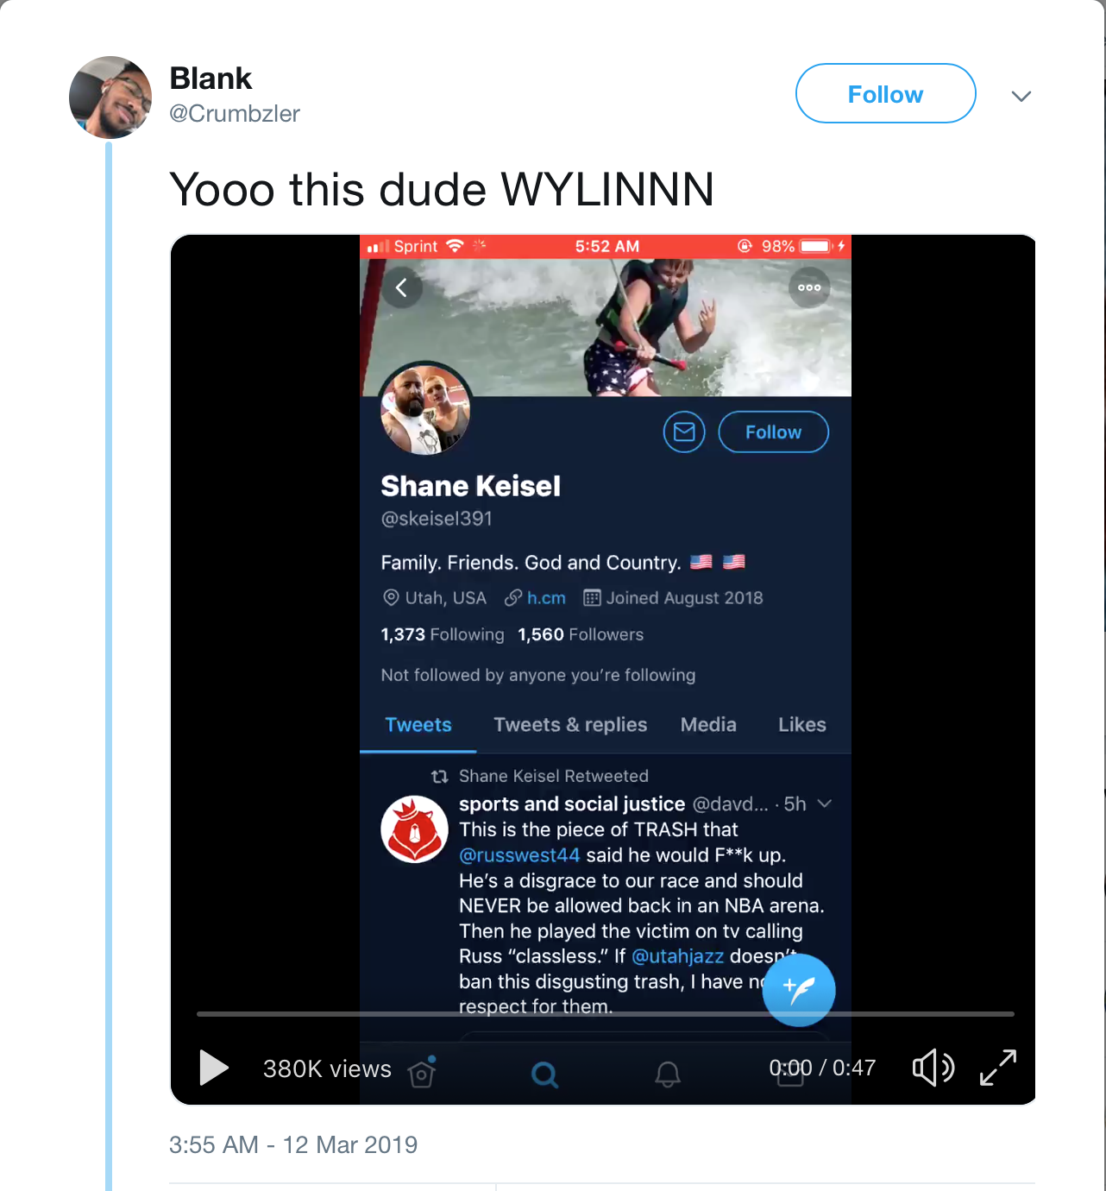
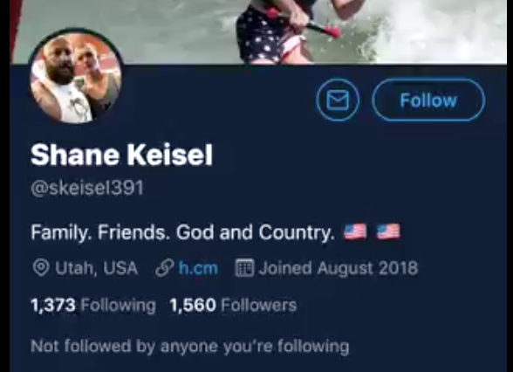
12 March video purports to show Keisel’s twitter feed
https://web.archive.org/web/20190330194026/https:/twitter.com/Crumbzler/status/1105422065203580932

Slide 7
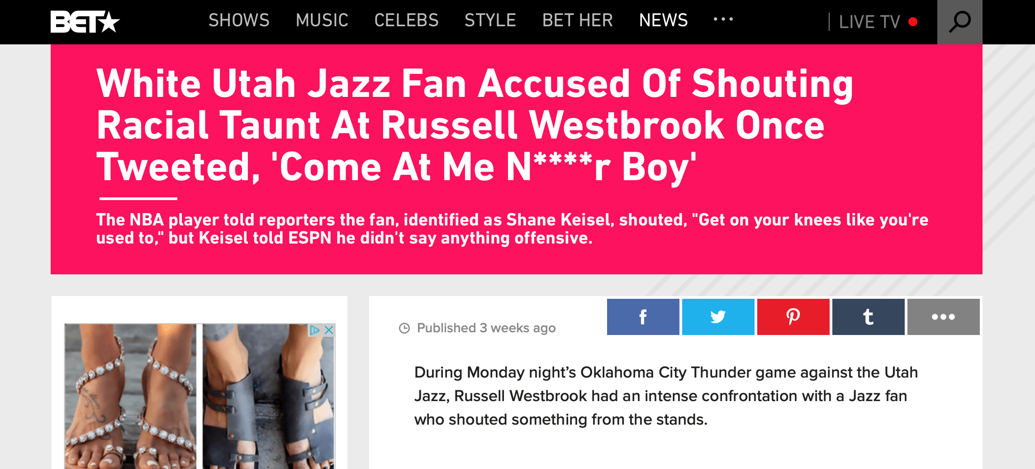
One of the tweets in the video made the news
https://web.archive.org/web/20190403173924/https://www.bet.com/news/sports/2019/03/12/white-utah-jazz-fan-who-reportedly-yelled-racial-taunt-at-okc-ga.html

Slide 8
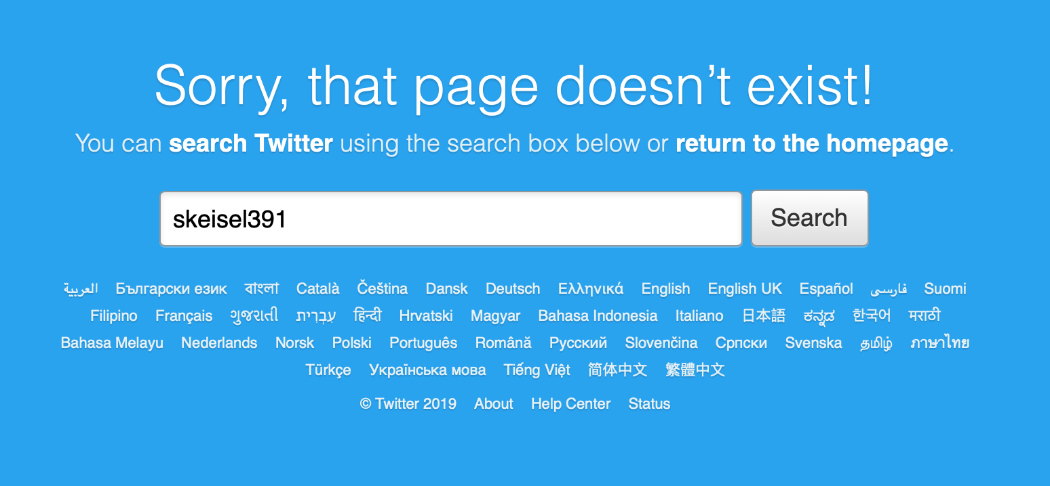
@skeisel391 has been deleted?
https://web.archive.org/web/*/https://twitter.com/skeisel391

Slide 9
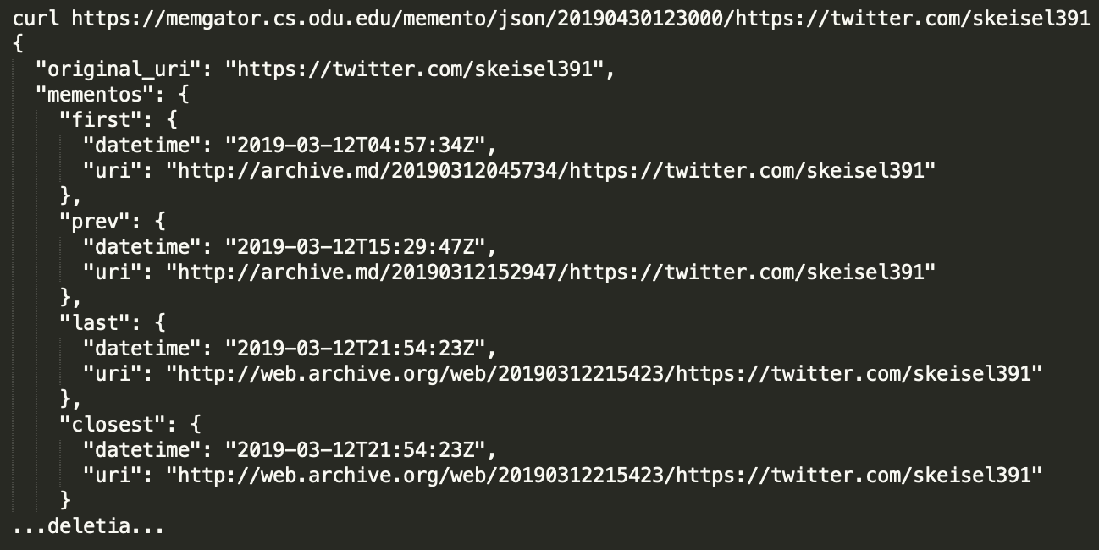
Only two mementos, both on Mar 12th, second is a redirect
12:57 AM EDT
curl https://memgator.cs.odu.edu/memento/json/20190430123000/https://twitter.com/skeisel391

Slide 10
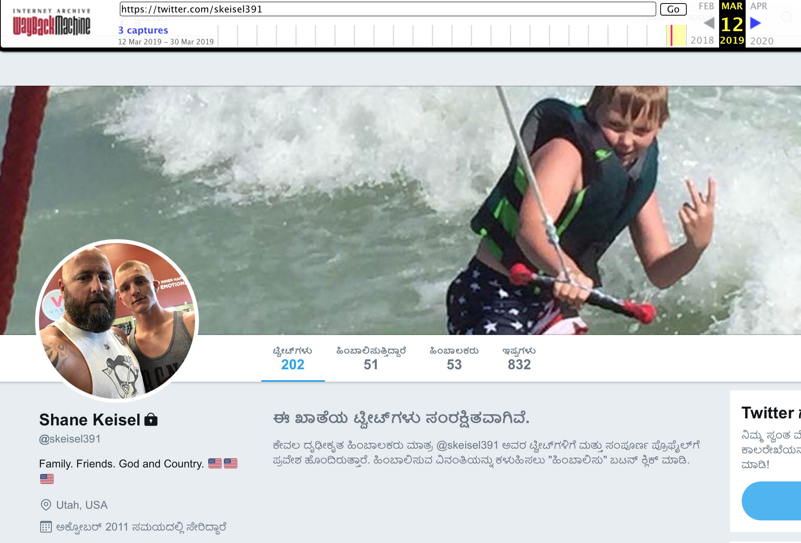
12 Mar, 4hrs after game starts, page is private
https://web.archive.org/web/20190312045057/https:/twitter.com/skeisel391

Slide 11
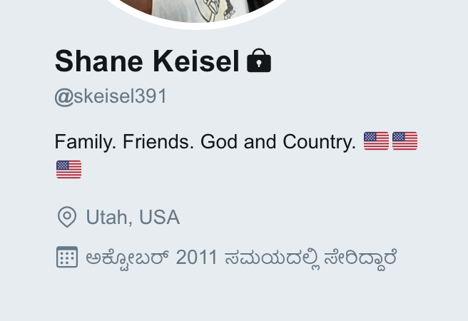
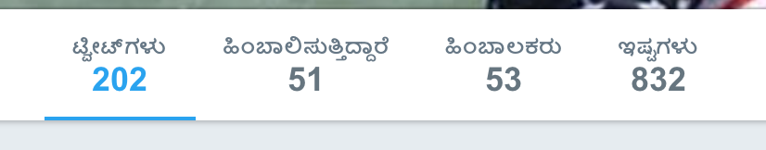
First glance, something fishy is going on
https://twitter.com/Crumbzler/status/1105422065203580932
https://web.archive.org/web/20190312045057/https:/twitter.com/skeisel391

Slide 12
Video shows a series of 5 tweets and retweets
RT @DavDavies who is responding to a Shane Keisler @skeisler391 tweet (#3 below)
RT @Jamez_316 who comments on a @skeisler391 tweet
@skeisler391 is responding to @phat_mayntana
RT @calibossanova, is unrelated to the others
@skeisler391’s response to @lyssa_a who subtweet’d with a screenshot of one of @skeisler391’s tweets
Why is he retweeting negative comments about himself?

Slide 13
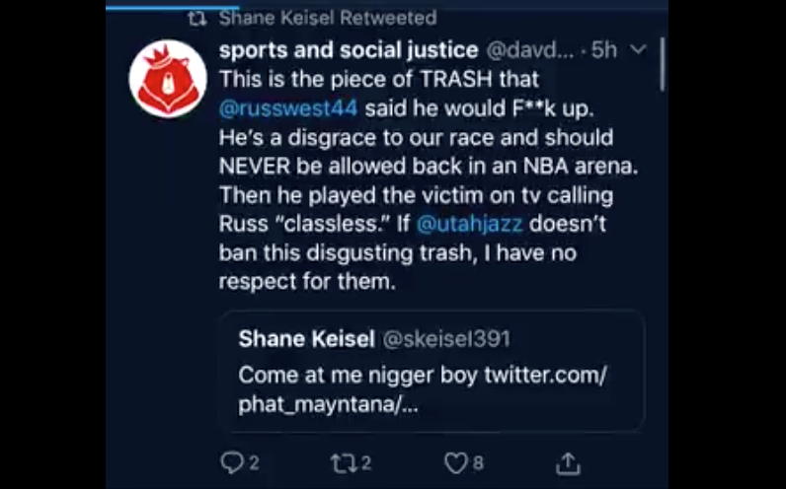
First retweet: @davdavies from the video
https://web.archive.org/web/20190330194026/https:/twitter.com/Crumbzler/status/1105422065203580932

Slide 14
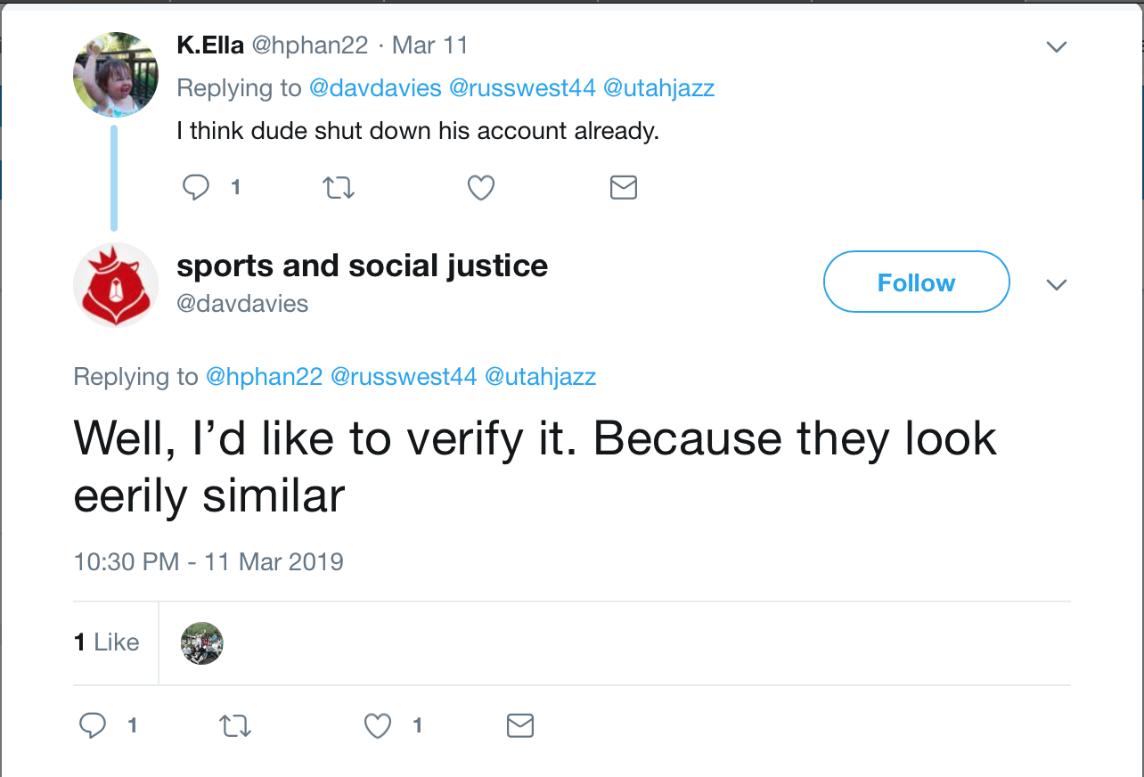
Only live tweet to mention @russwest44 on 11 Mar
https://web.archive.org/web/20190330194346/https:/twitter.com/davdavies/status/1105340340985315328

Slide 15
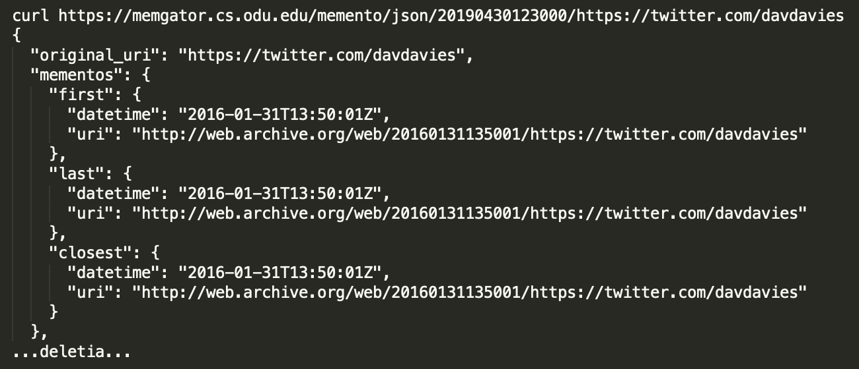
1 memento from 2016
curl https://memgator.cs.odu.edu/memento/json/20190430123000/https://twitter.com/davdavies

Slide 16
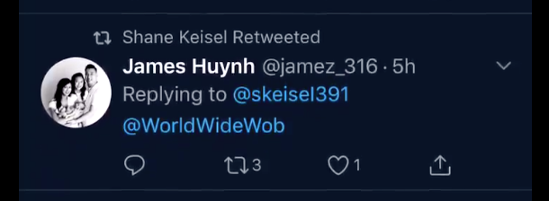
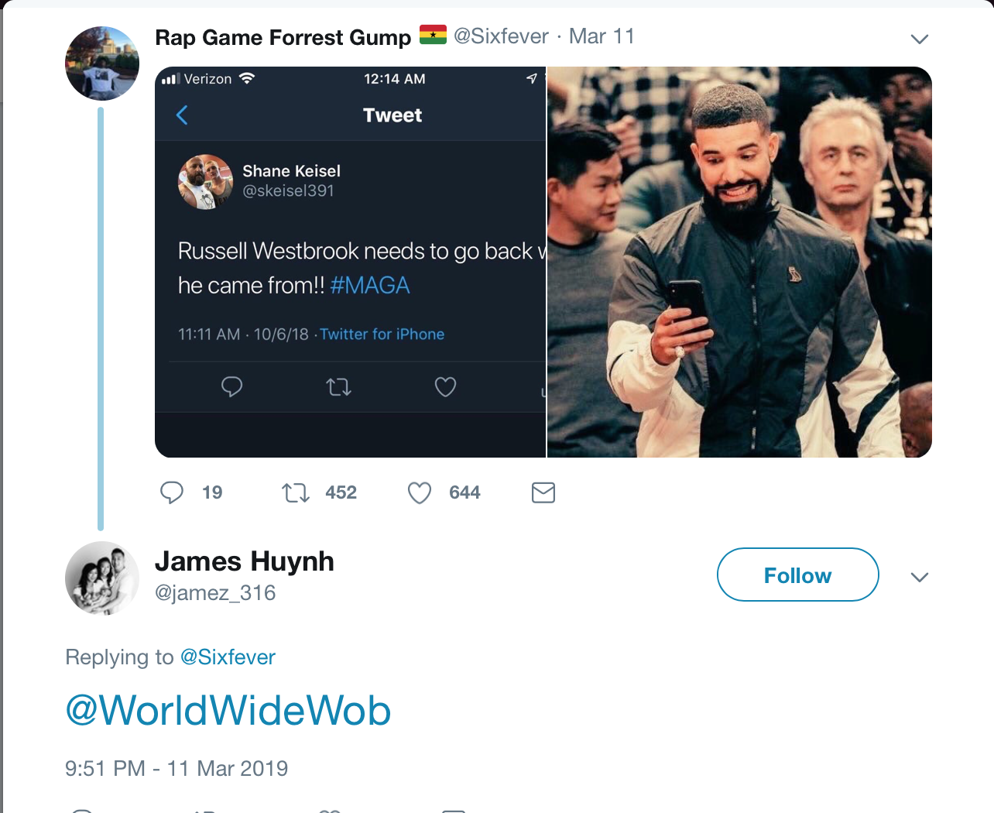
2nd retweet: this reply is not on James page
There was however a conversation going on between @jamez_316 and @WorldWideWob. It’s not unlikely that other things were posted and since deleted.
https://web.archive.org/web/20190330193754/https:/twitter.com/jamez_316/status/1105330328502194176

Slide 17
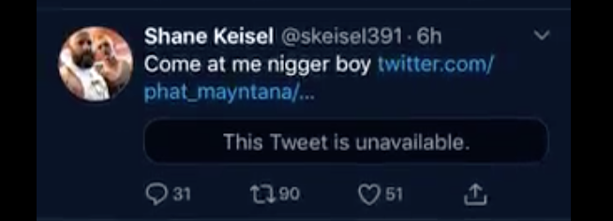
3rd tweet is a response to @phat_mayntana

Slide 18
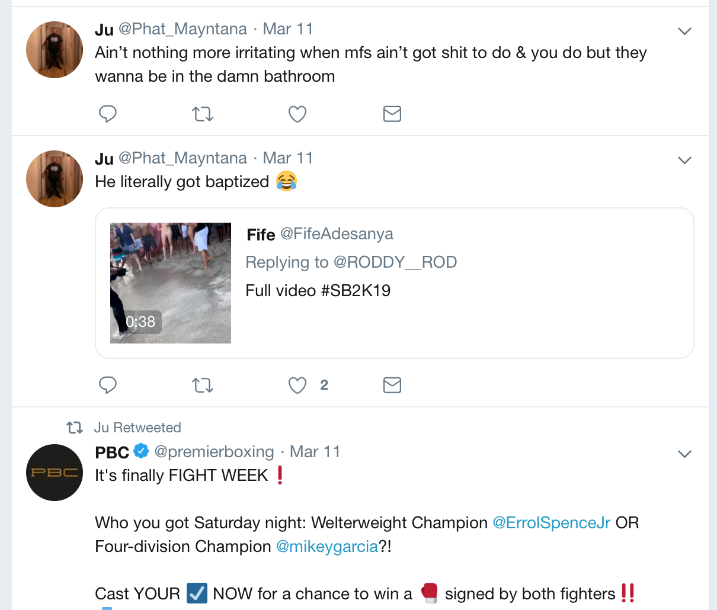
Nothing in his feed is relevant to Russell Westbrook
https://twitter.com/Phat_Mayntana

Slide 19
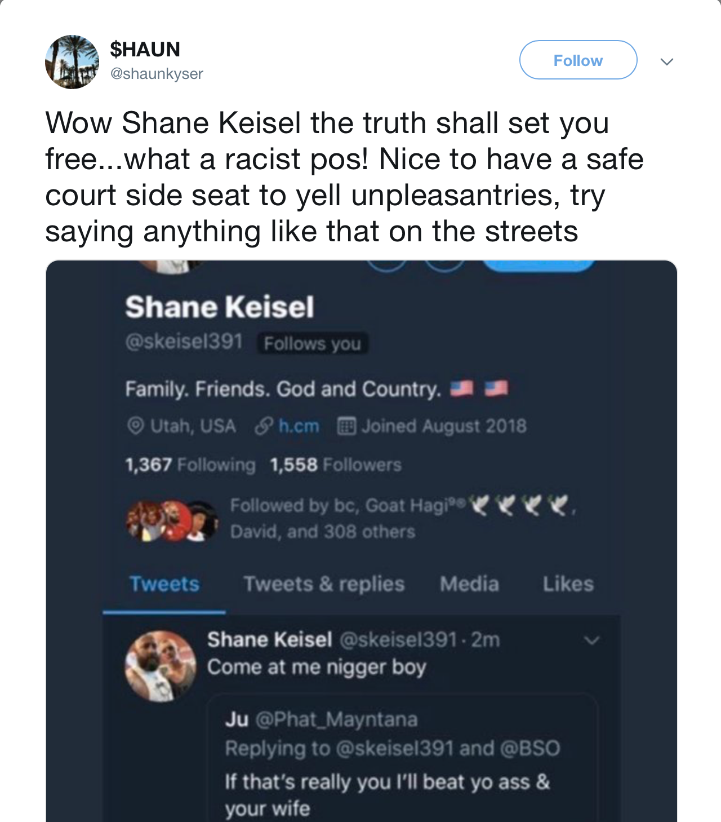
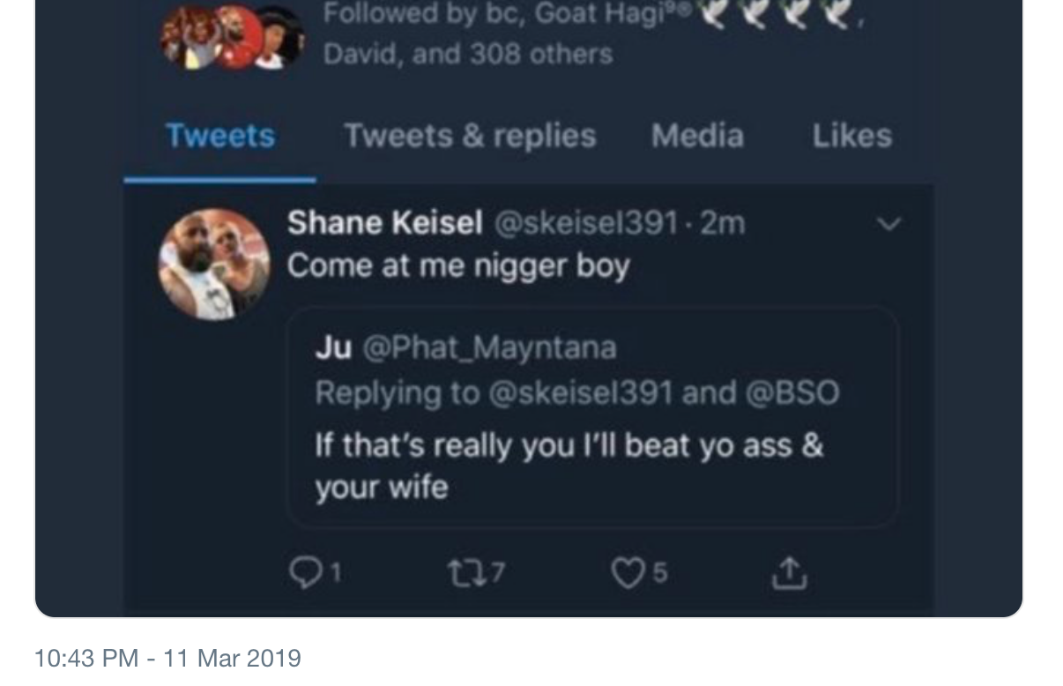
Possibly what was said, but the screen shot looks altered
https://web.archive.org/web/20190403150403/https://twitter.com/shaunkyser/status/1105343606548684800

Slide 20
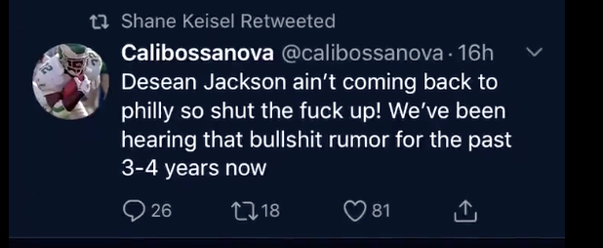
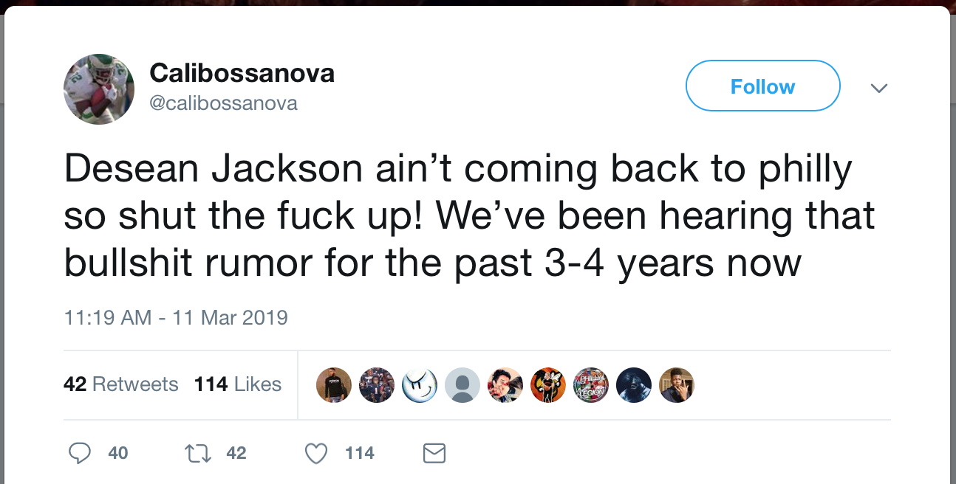
4th retweet is a real tweet from @Calibossanova
https://web.archive.org/web/20190330214035/https:/twitter.com/calibossanova/status/1105171423012646912

Slide 21
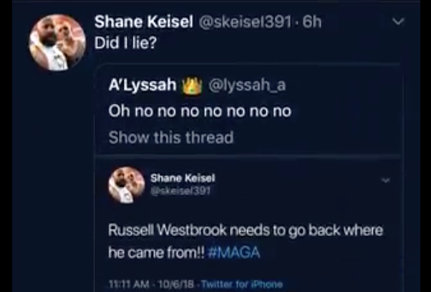
5th tweet is an exchange with @lyssah_a
Notice that the response is 6h old at the time of the video

Slide 22
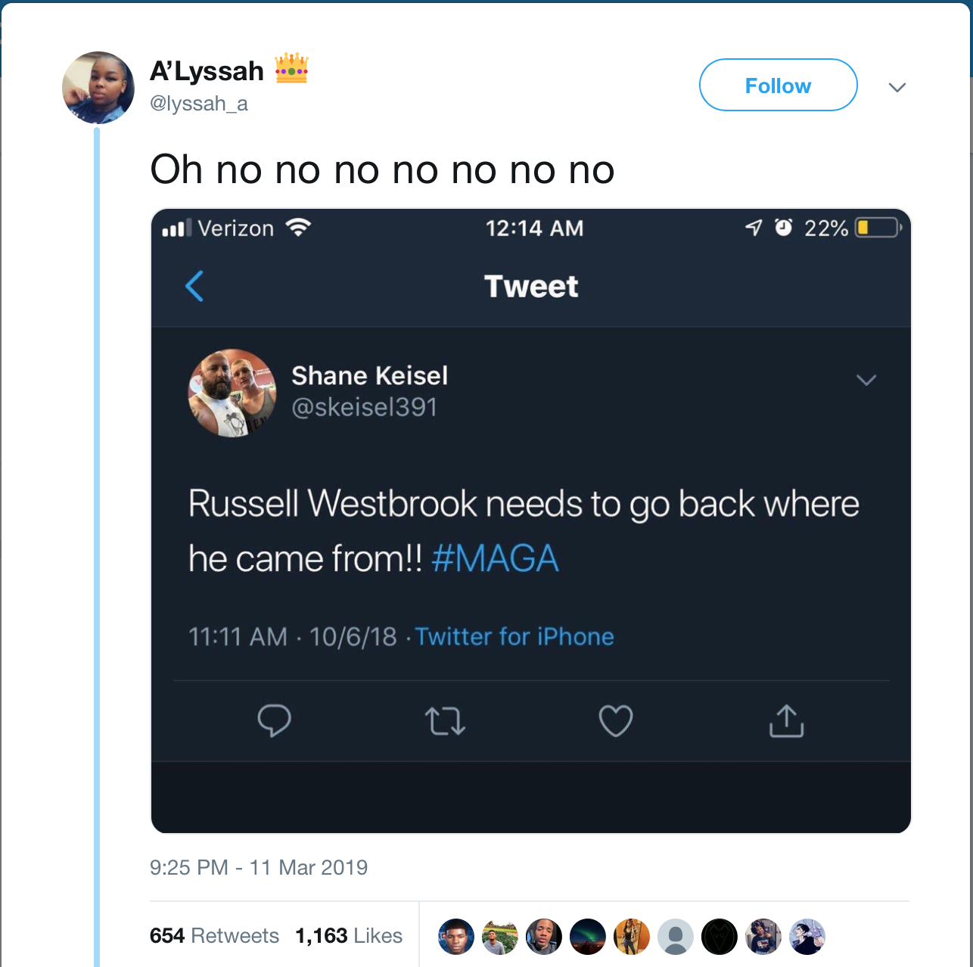
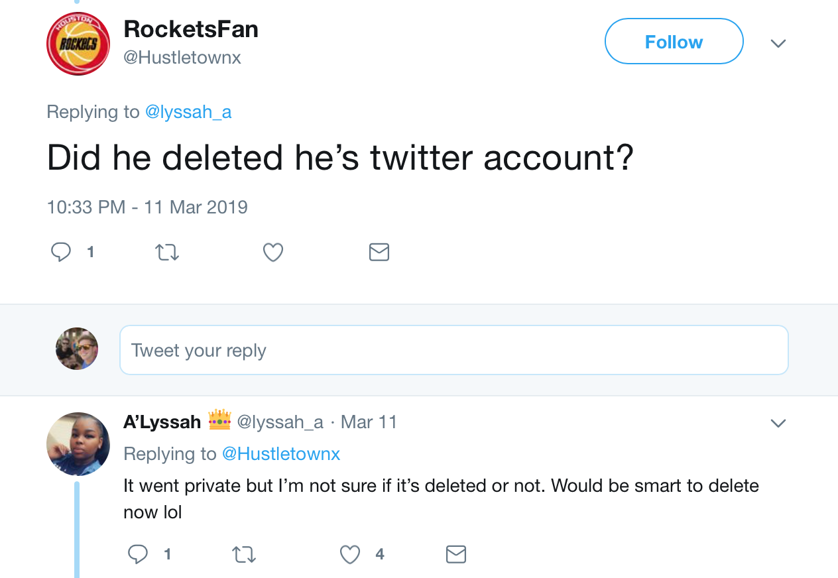
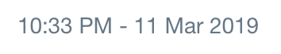
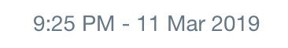
The tweet Keisel was responding to exists, there is no reaction in the comments to Keisel’s response
Game started at 9:00 PM ET 11 Mar 2019
https://web.archive.org/web/20190330151627/https:/twitter.com/lyssah_a/status/1105323795609337856
https://web.archive.org/web/20190331202437/https://twitter.com/Hustletownx/status/1105341098086391809

Slide 23
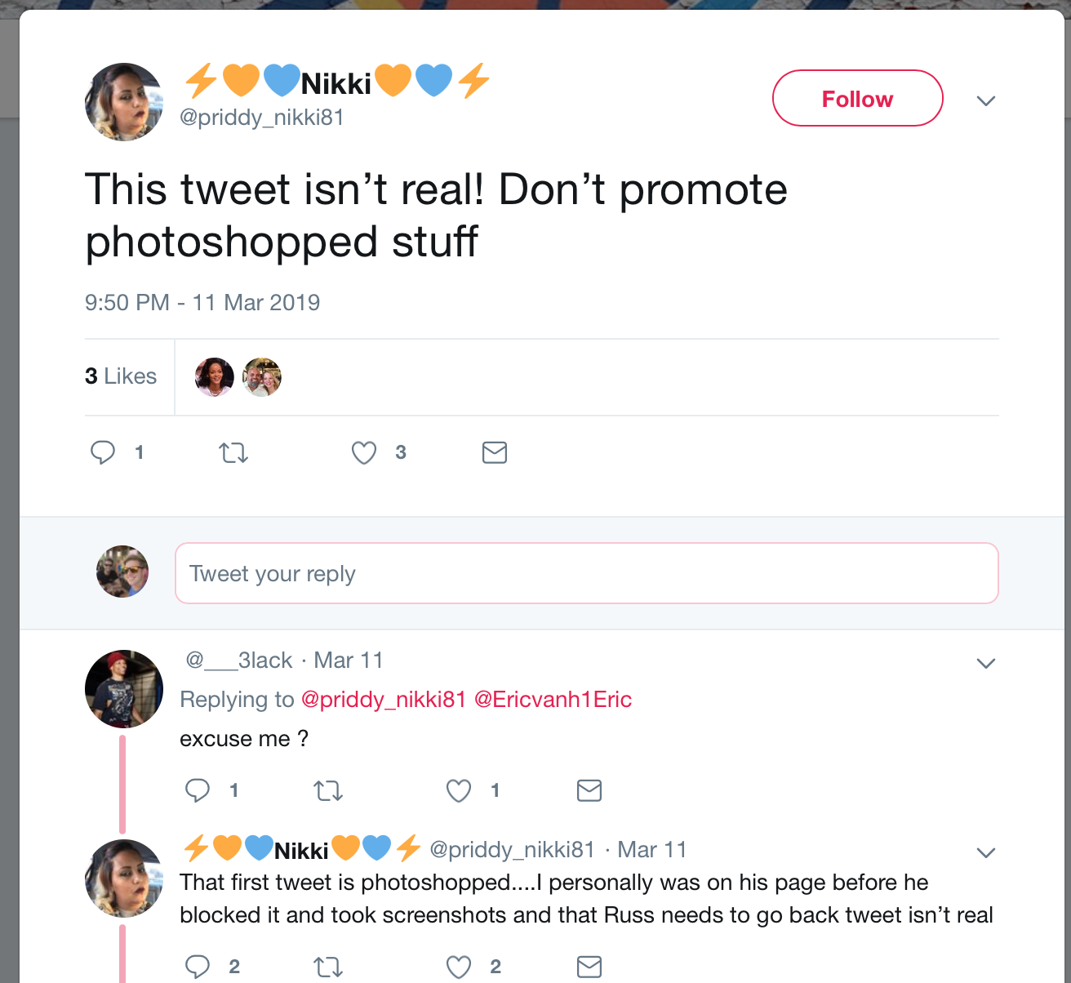
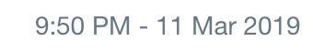
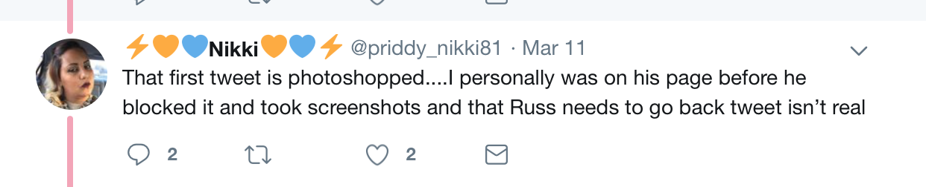
One user does call the screen shot into question
https://web.archive.org/web/20190331204953/https:/twitter.com/priddy_nikki81/status/1105330179423887360

Slide 24
Results from the video
RT @DavDavies DELETED
RT @Jamez_316 DELETED
Response to @phat_mayntana DELETED
RT @calibossanova Live
Response to @lyssa_a Live
Associated with the same derogatory tweet

Slide 25
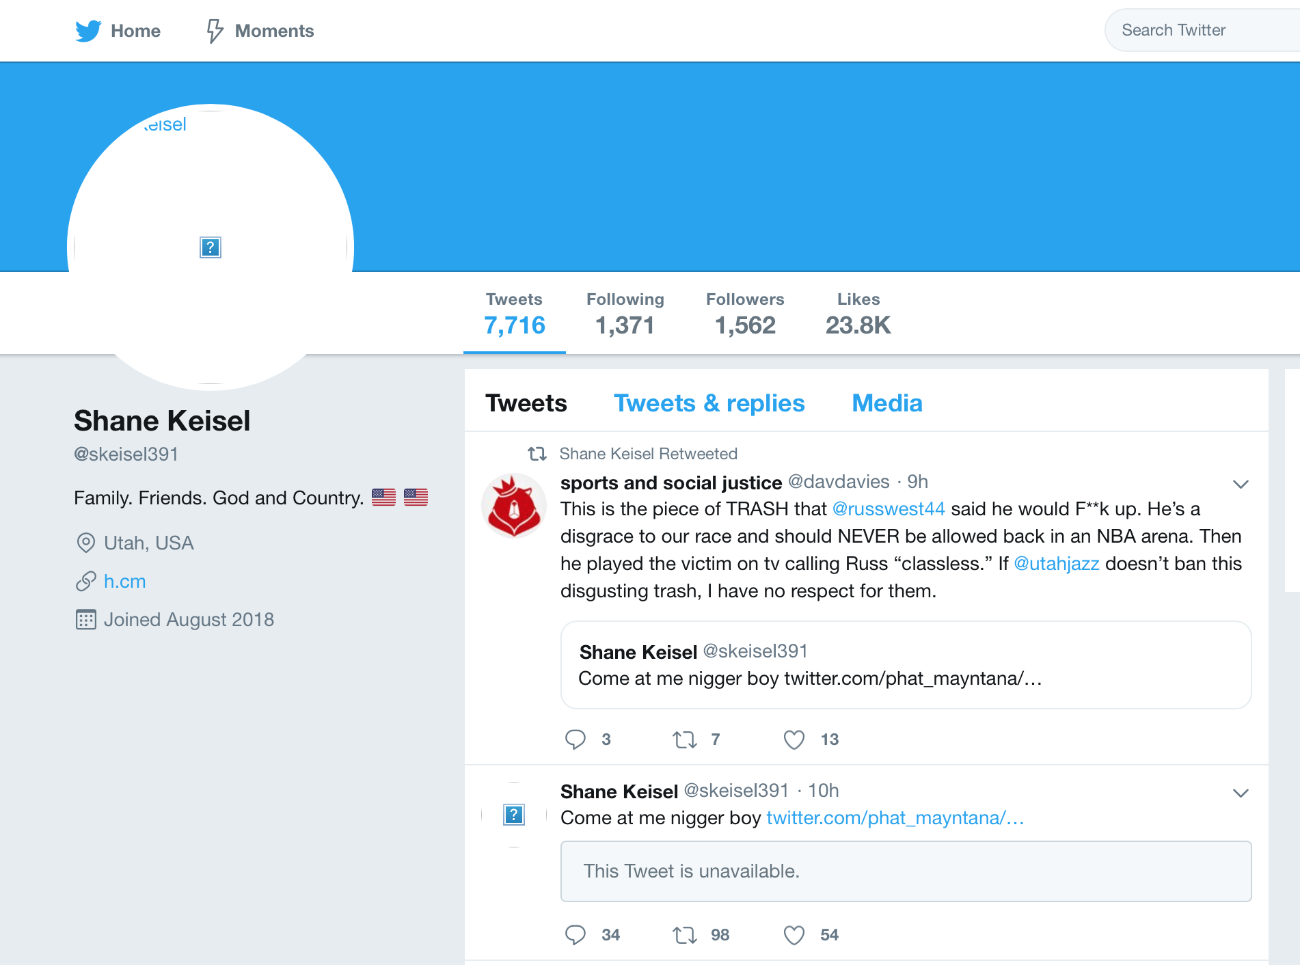
In the Google cache… twitter.com\skeisel391
https://web.archive.org/web/20190403162605/https://webcache.googleusercontent.com/search?q=cache:hKTlzVDbEZAJ:https://twitter.com/skeiseI391+&cd=2&hl=en&ct=clnk&gl=us

Slide 26
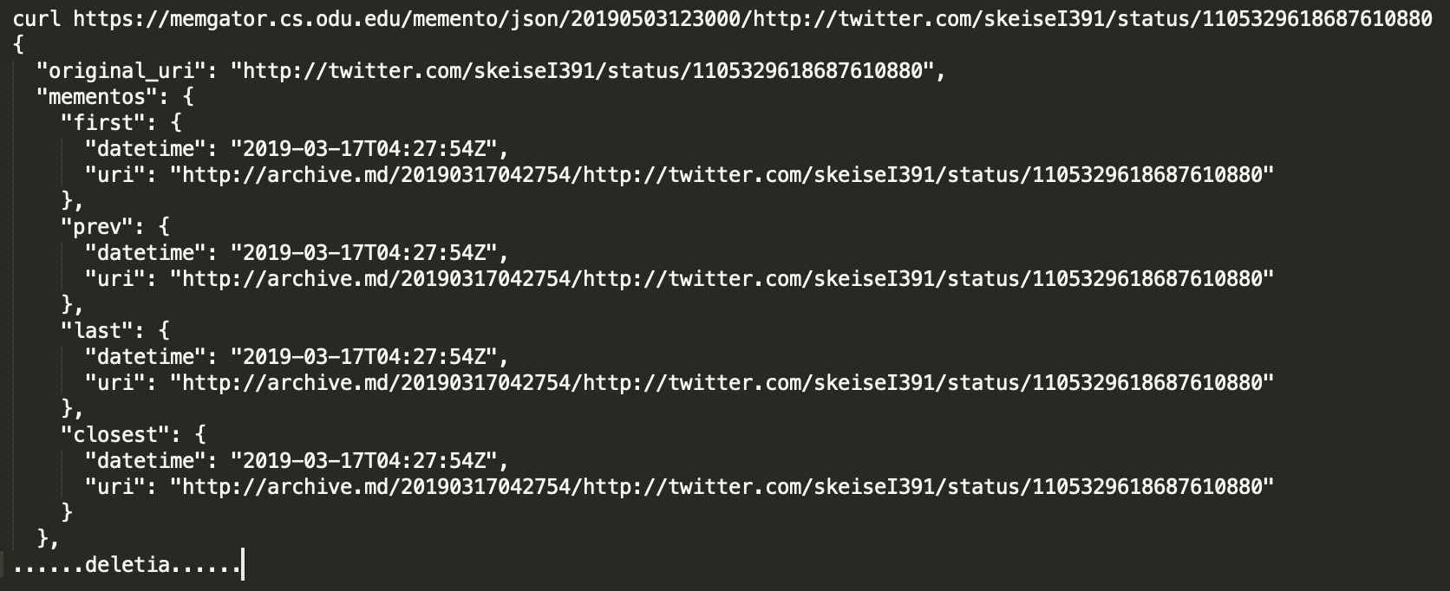
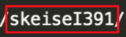
And it’s in the archive! BUT…..

Slide 27
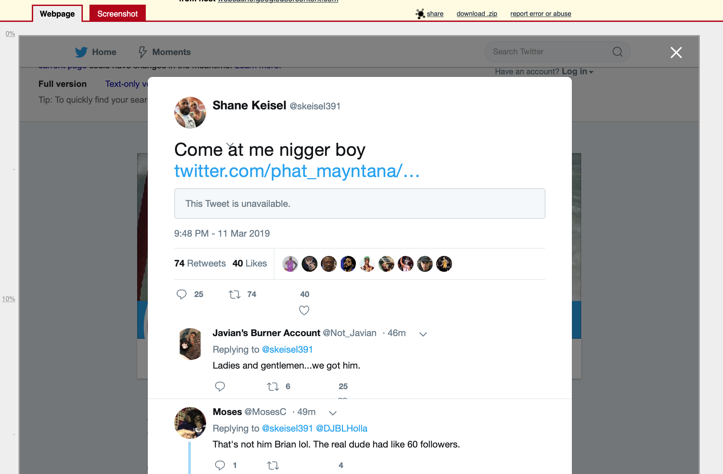
Archive.md,
http://archive.md/20190317042754/http://twitter.com/skeiseI391/status/1105329618687610880

Slide 28
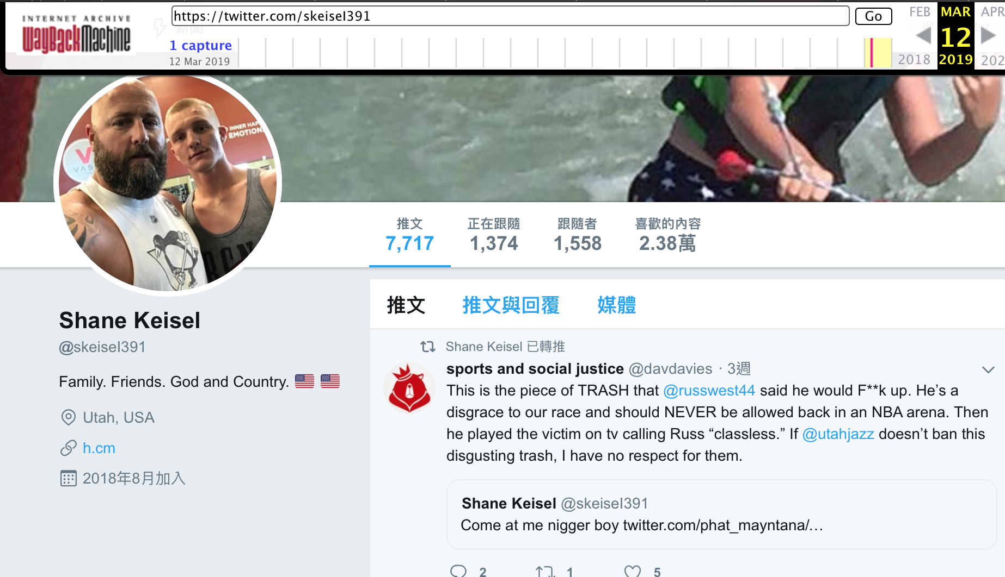
@skeise capital i 391 is also in the archive, but not live
https://web.archive.org/web/20190312061305/https:/twitter.com/skeiseI391

Slide 29
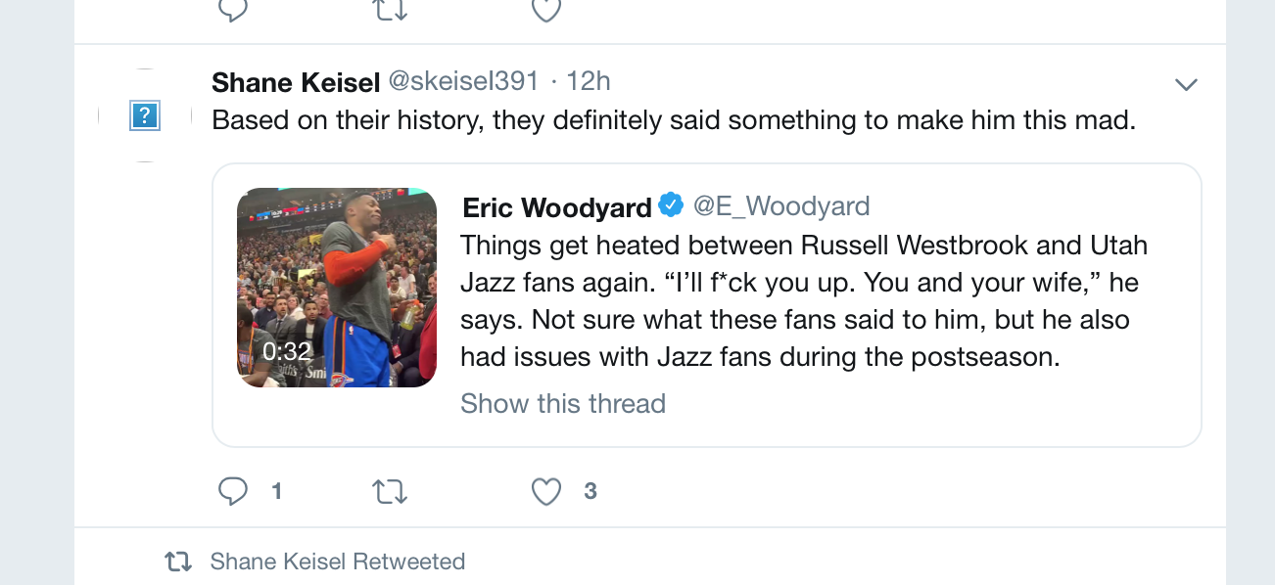
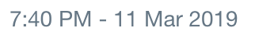
At some point, they stopped talking about Keisel in the 3rd person, probably after they changed their handle
https://web.archive.org/web/20190403162605/https://webcache.googleusercontent.com/search?q=cache:hKTlzVDbEZAJ:https://twitter.com/skeiseI391+&cd=2&hl=en&ct=clnk&gl=us

Slide 30
Who is the real Shane Keisel?
FAKE
REAL

Slide 31
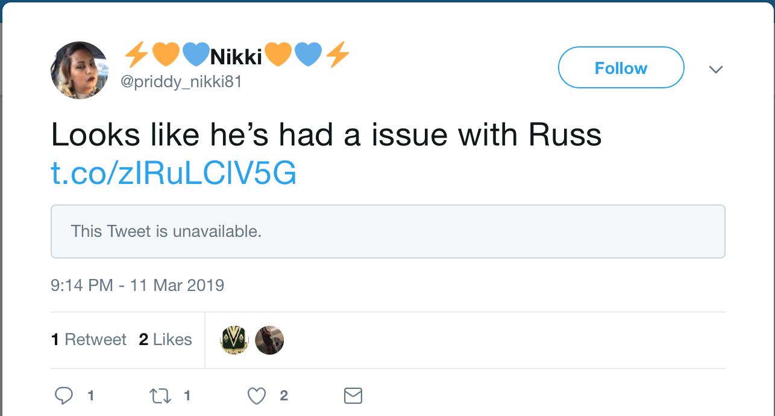
Only direct link on the live web to a @skeisel391 tweet
https://twitter.com/skeisel391/status/990226557875580928
https://web.archive.org/web/20190331202715/https:/twitter.com/priddy_nikki81/status/1105321177336111105

Slide 32
No mementos found
https://twitter.com/skeisel391/status/990226557875580928

Slide 33
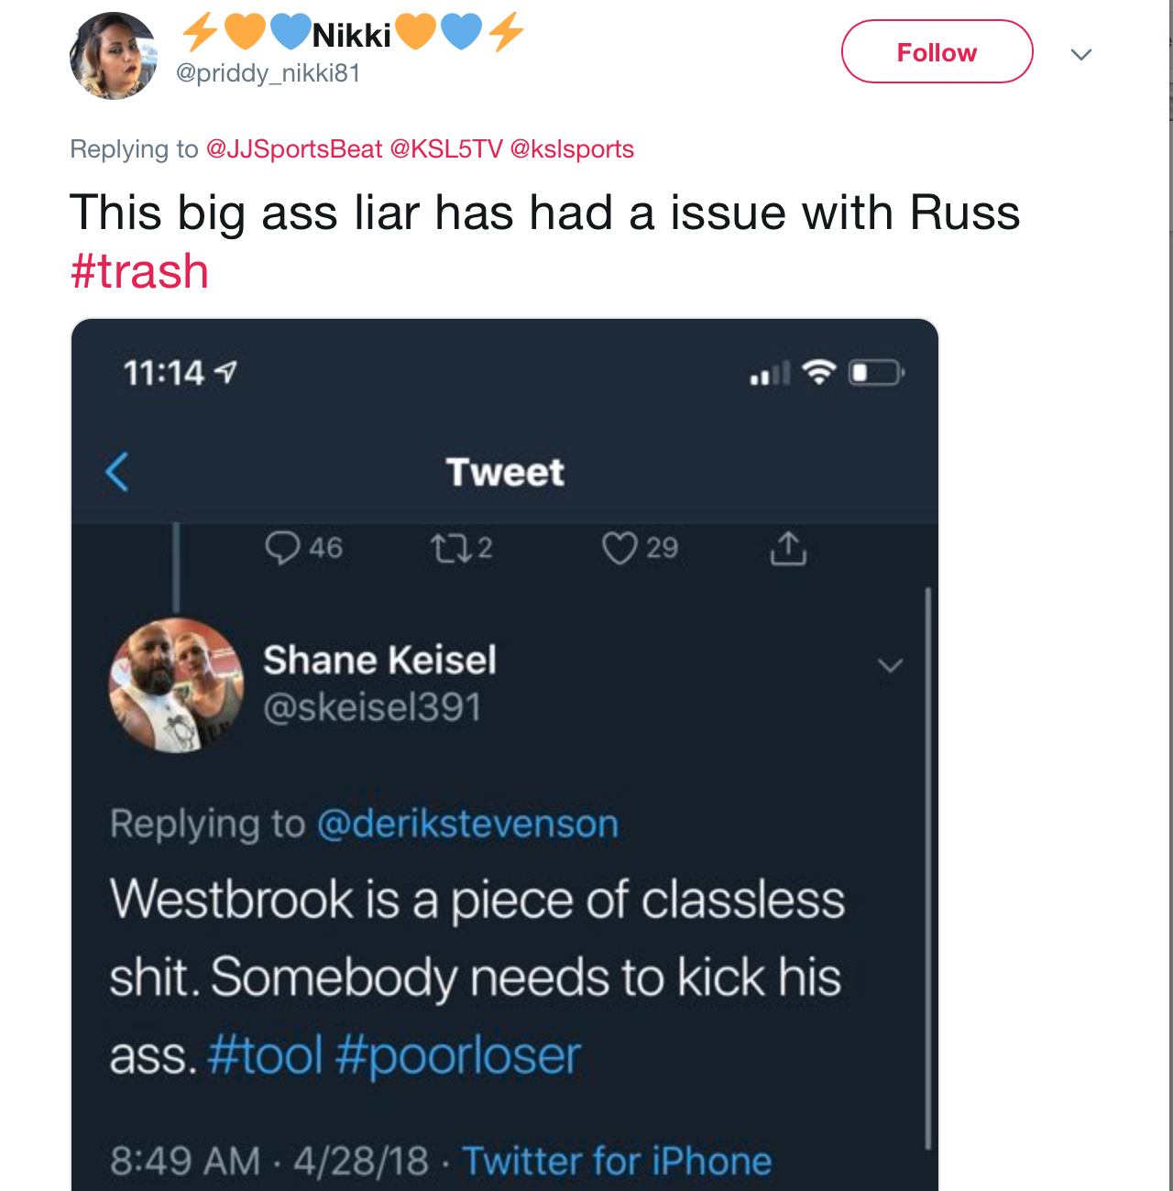
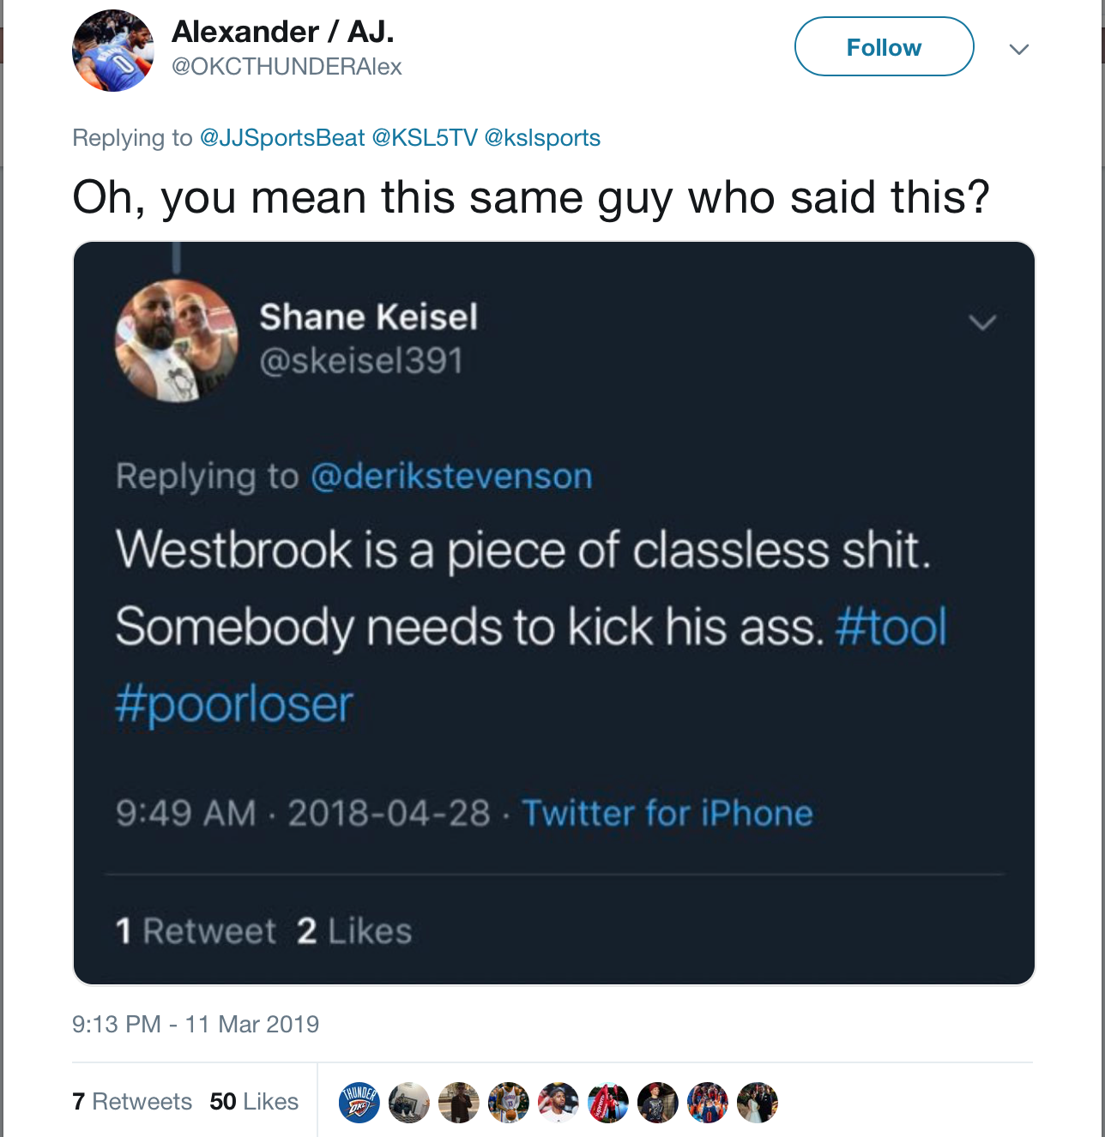
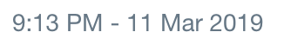
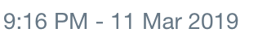
This screenshot is most likely the tweet she is referencing
Screenshot is from
28 APR 18
during
Pre Season Playoffs in Utah
https://web.archive.org/web/20190331205301/https:/twitter.com/priddy_nikki81/status/1105321626256592898
https://web.archive.org/web/20190330150918/https:/twitter.com/OKCTHUNDERAlex/status/1105320947668594688

Slide 34
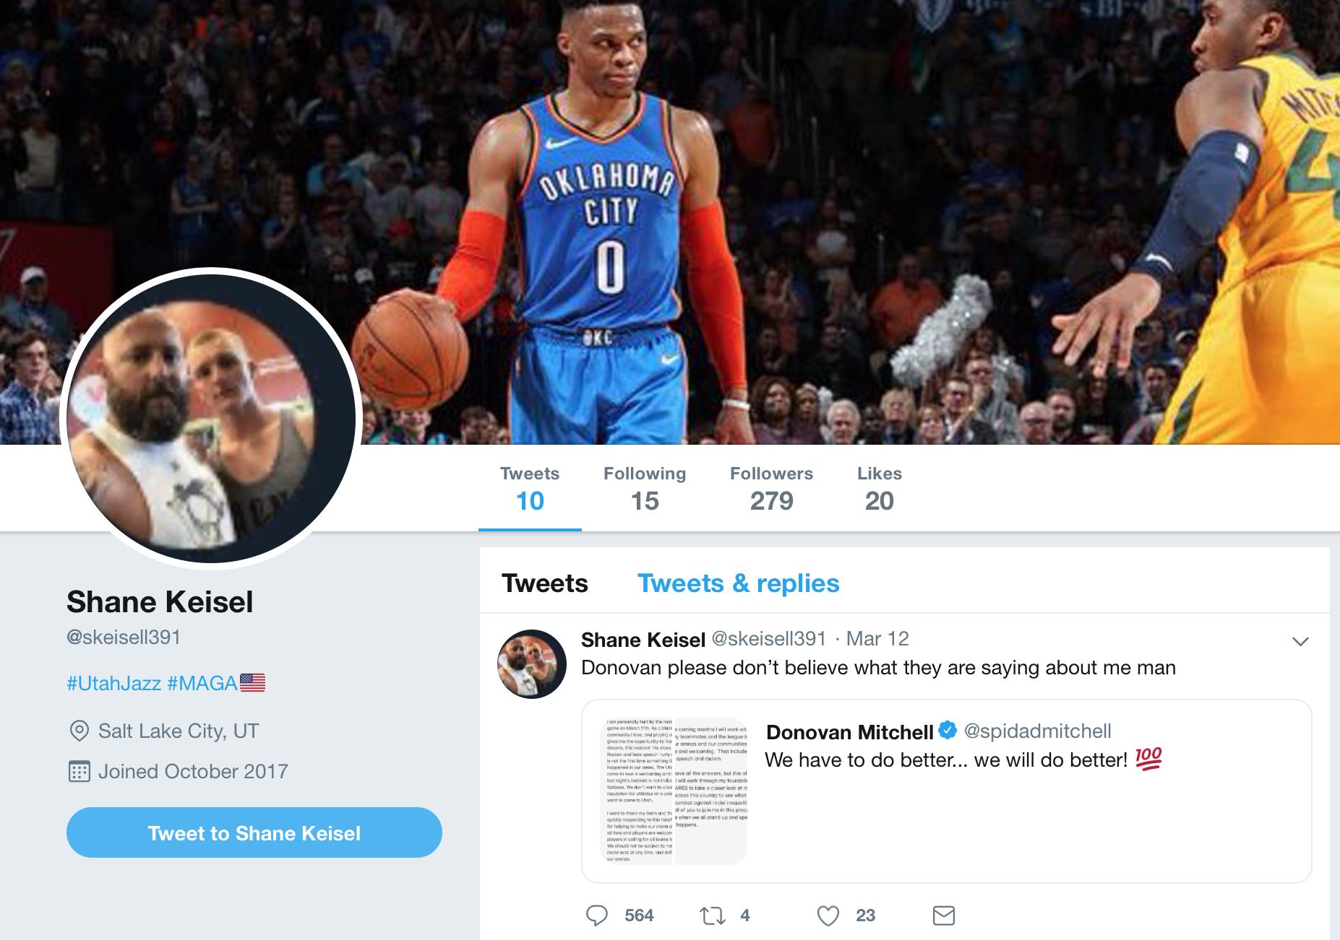
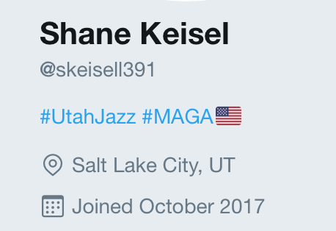
@skeisell391 If this is him, why is the Profile pic so poor quality?
https://web.archive.org/web/20190403152246/https:/twitter.com/skeisell391

Slide 35
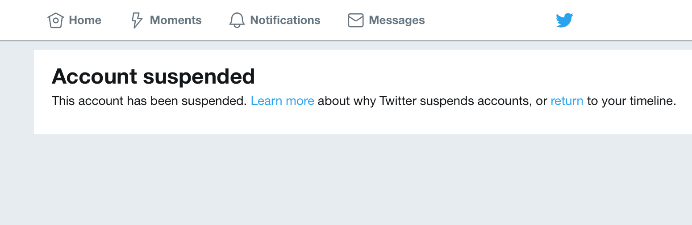
@skeisel391_
https://twitter.com/skeisel391

Slide 36
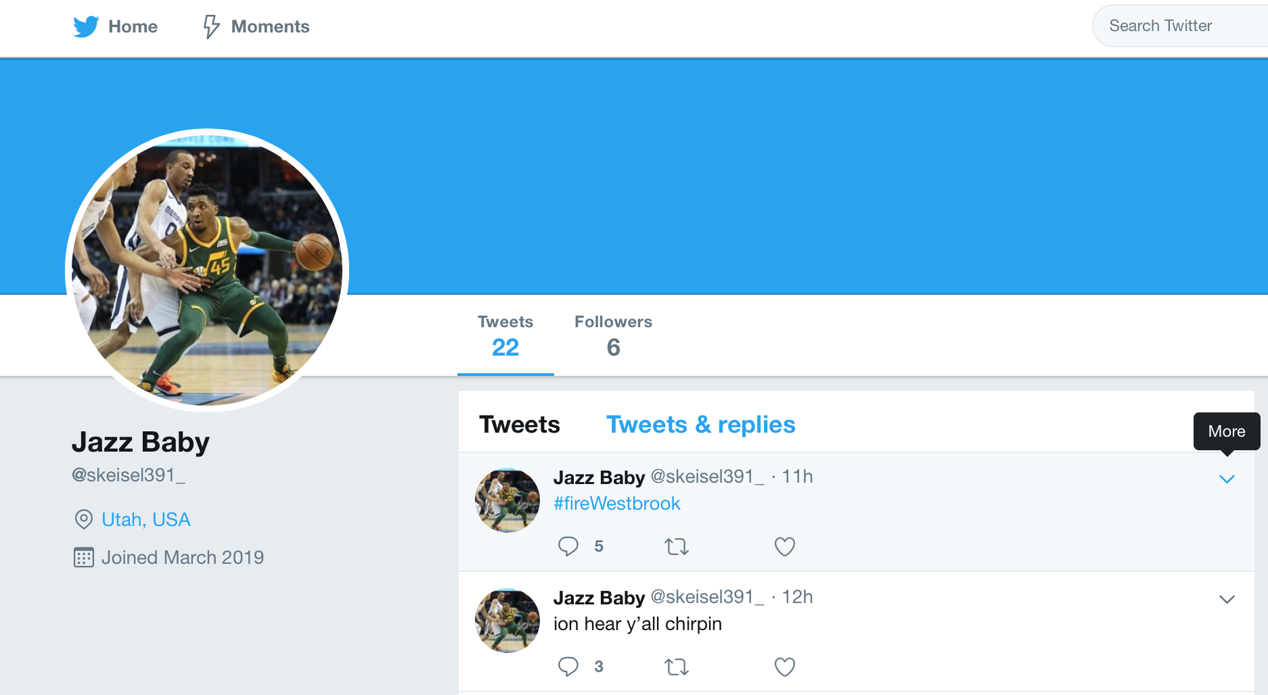
In the cache: Suspiciously new account
https://web.archive.org/web/20190403160210/https://webcache.googleusercontent.com/search?q=cache:QhS8DJRG9SEJ:https://twitter.com/skeisel391_+&cd=1&hl=en&ct=clnk&gl=us&client=safari

Slide 37
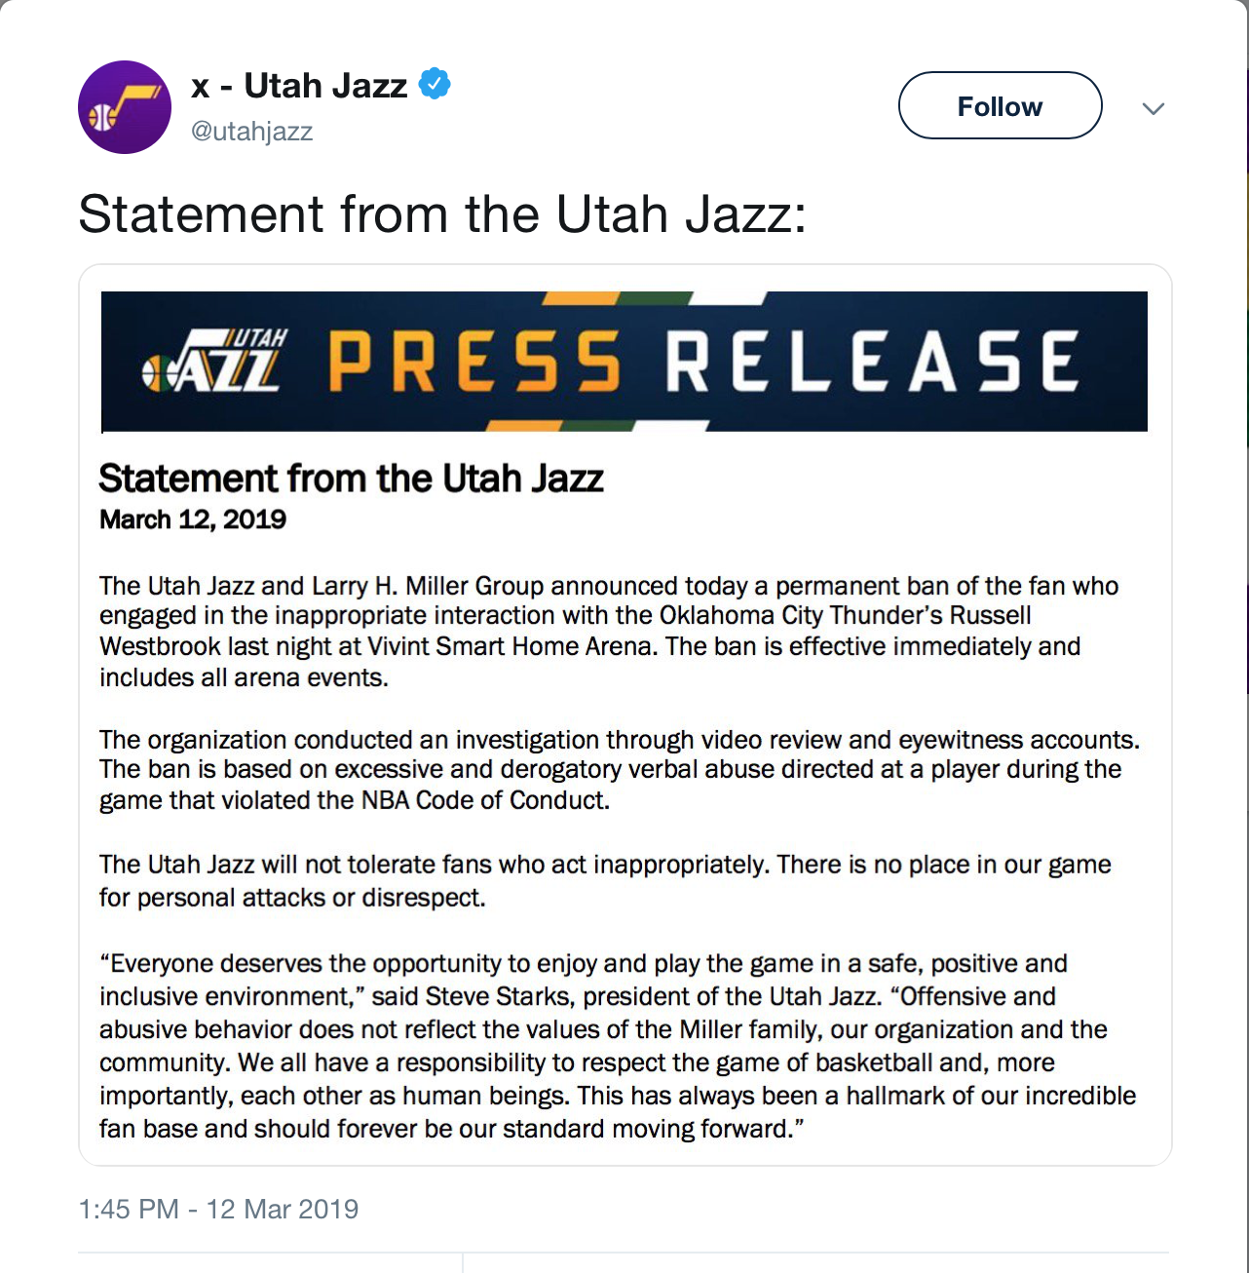


Jazz did their own investigation, and banned Keisel
https://twitter.com/utahjazz/status/1105570407598321664

Slide 38

They also banned the fan from 2018 altercation
https://www.deseretnews.com/article/900060598/utah-jazz-issue-second-permanent-ban-on-fan-from-2018-playoff-video-that-surfaced-against-russell-westbrook.html

